Slide 1
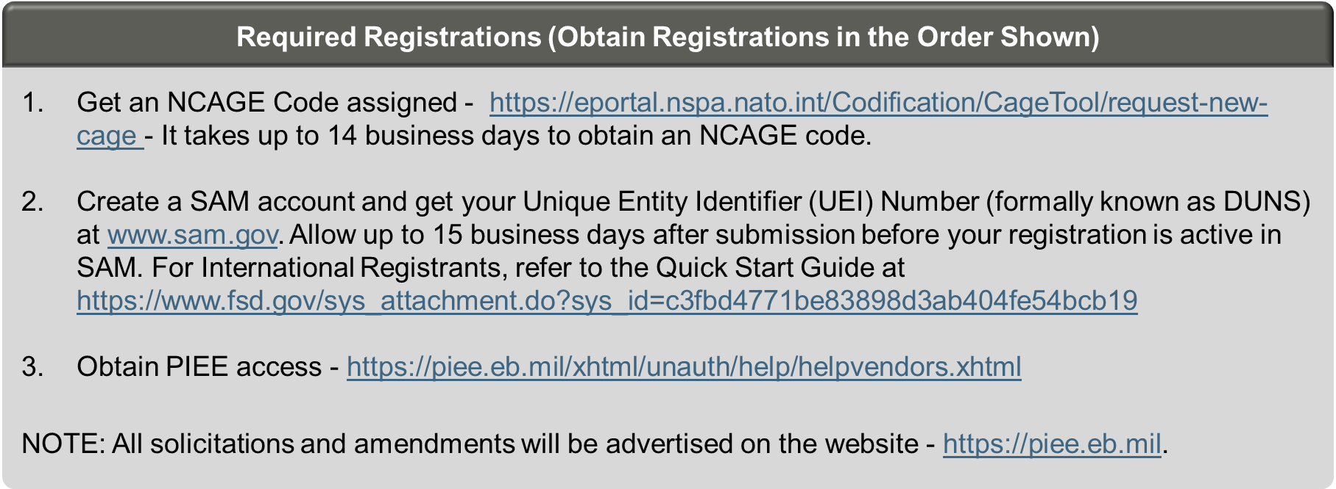
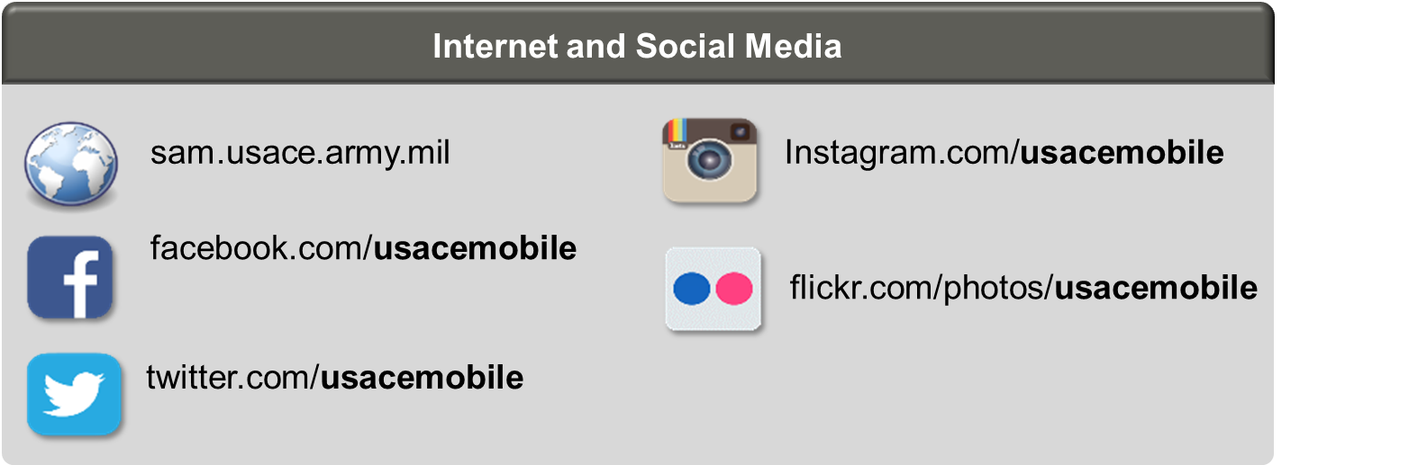



Registering to compete on us army corps of engineers construction contracts in Latin America
Virtual Industry Day – Registration Requirements Information
Wednesday, Feb 15, 2023, 10:00-11:00 am Central Time (US & Canada)
https://usace1.webex.com/usace1/j.php?MTID=m1da5908e27cb76961e6ded29f194c609
Meeting number: 2763 937 1627 Password: N35fEHGyJ?6
Agenda: Introduce the requirements for registering in US Government systems to allow future participation in contract competitions in Peru and other locations.
Join by phone
+1-844-800-2712 US Toll Free
+1-669-234-1177 US Toll Access code: 276 393 71627
The United States Army Corps of Engineers (USACE) works with partner nations in the region on engineering efforts and has future regional requirements for construction and renovations. USACE is seeking contractors with experience in design, construction, and repair of facilities, utilities, and infrastructure.
A virtual meeting will be held on 15 February to share information on the advance registration that is required to compete on USACE solicitations. Also, an in-person pre-proposal conference will be held in Lima, Peru in March, focusing on how to submit a proposal. Interested contractors may contact Claudia Montero at claudia.m.montero@usace.army.mil for additional information and to register for the conference. Participants are asked to obtain their NCAGE Code prior to attending the event.
Solicitations will only be announced on https://SAM.gov and can only be downloaded from and proposals submitted through https://piee.eb.mil. Registration on the sites listed on this announcement is required for participation in the competition.

